Slide 1
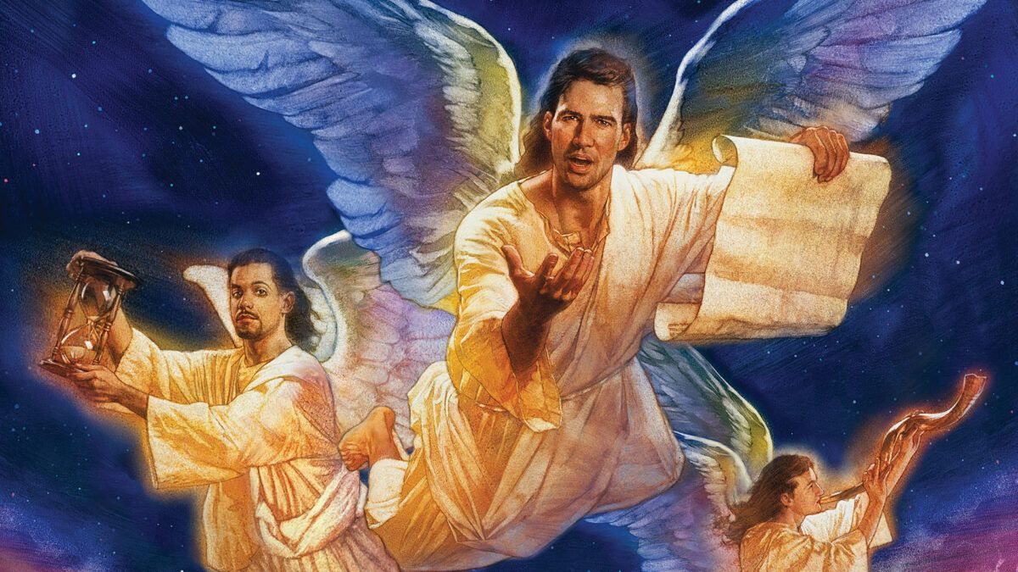
God’s Final Warning!

Slide 2

Rev 12:9
And the great dragon was cast out, that old serpent, called the Devil, and Satan, which deceiveth the whole world: he was cast out into the earth, and his angels were cast out with him.

Slide 3
Rev 13:3
And I saw one of his heads as it were wounded to death; and his deadly wound was healed: and all the world wondered after the beast.
Rev 13:4 And they worshipped the dragon which gave power unto the beast: and they worshipped the beast, saying, Who is like unto the beast? who is able to make war with him?

Slide 4
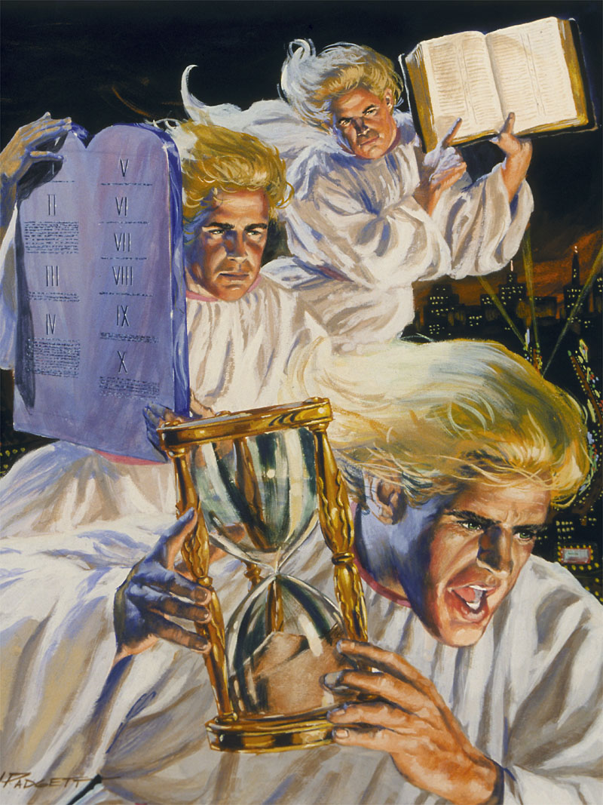
Rev 14:7
Fear God, and give glory to him; for the hour of his judgment is come: and worship him that made heaven, and earth, and the sea, and the fountains of waters.
Notes:
The final message is spelled out in Revelation 14:6-12
Tonight we will focus on the first message and see what we can learn.
These three messages build on each other so we will take it one step at a time.
We will allow the Bible to explain itself for us.

Slide 5

202: We firmly believe and confess without reservation that there is only one true God, … the Father and the Son and the Holy Spirit; three persons indeed, but one essence, substance or nature entirely simple.
234 The mystery of the Most Holy Trinity is the central mystery of Christian faith and life. It is the mystery of God in himself. It is therefore the source of all the other mysteries of faith, the light that enlightens them.

Slide 6
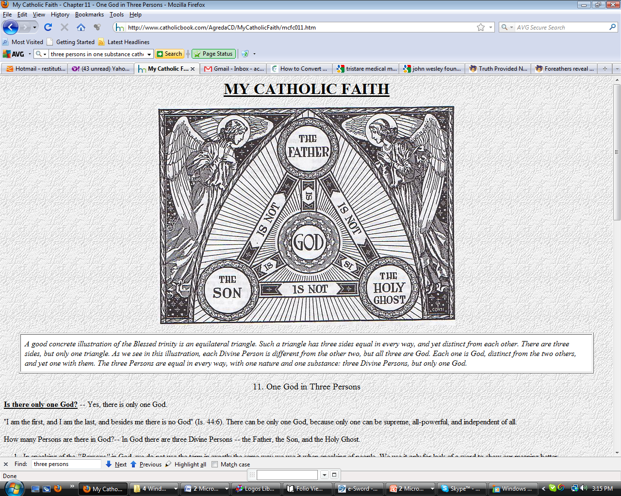

Notes:
This is the god of today’s Jezebel!
Did history repeat itself? We saw that christians have committed fornication with the women?
The question is are they worshiping her god (like Ahab)?

Slide 7
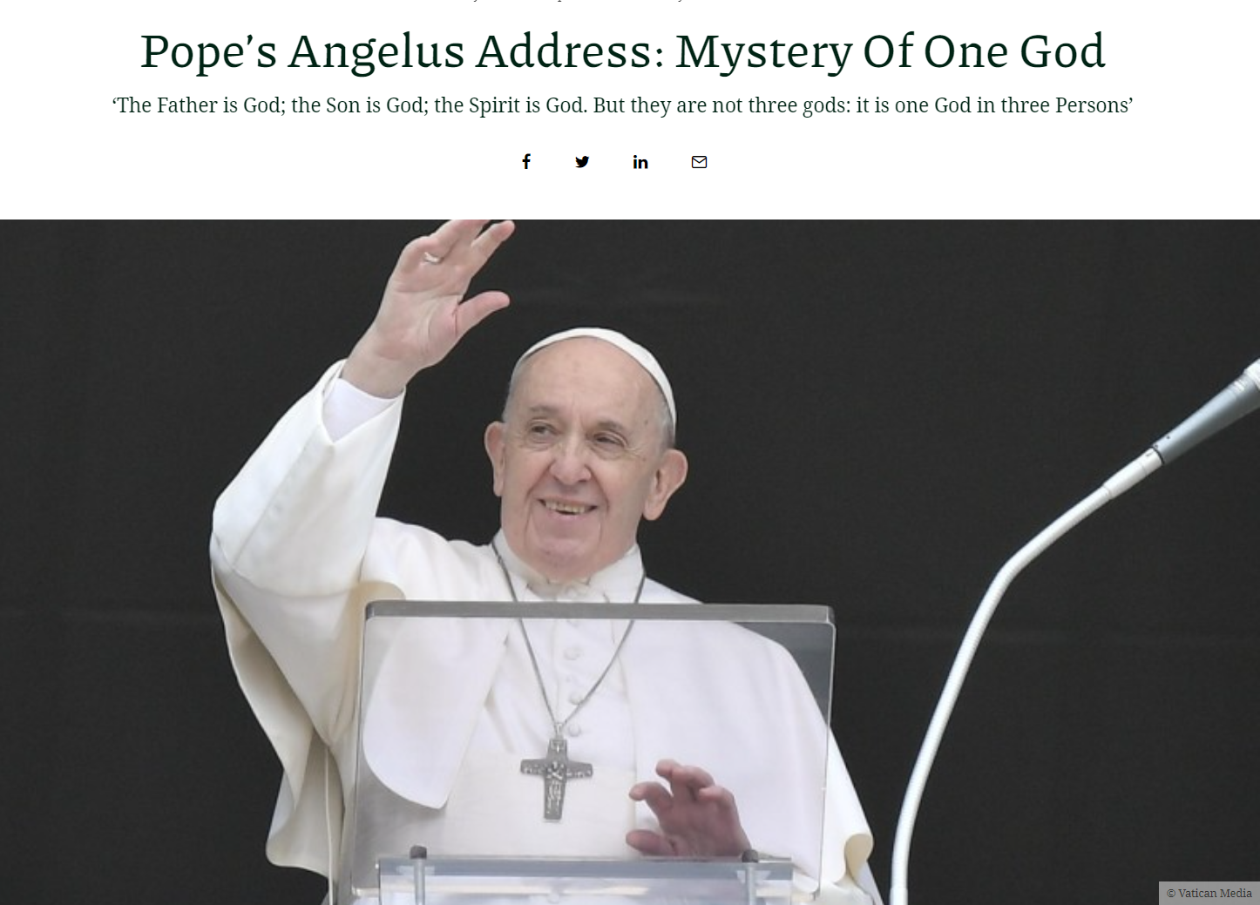
“And this God is the Father and the Son and the Holy Spirit. Three persons, but God is one!
“The Father is God; the Son is God; the Spirit is God. But they are not three gods: it is one God in three Persons.
“It is a mystery that Jesus Christ revealed to us: the Holy Trinity.”
May 30, 2021
https://www.exaudi.org/popes-angelus-address-mystery-of-one-god/

Slide 8


BELIEF 2: THE TRINITY
There is one God: Father, Son, and Holy Spirit, a unity of three coeternal Persons.
https://www.adventist.org/beliefs/

Slide 9
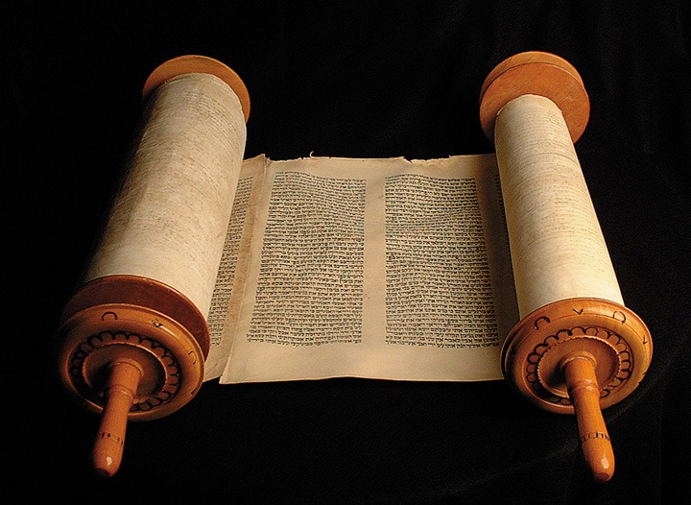
How Many Gods?
Deuteronomy 6:4
Hear, O Israel: The LORD our God is one LORD.

Slide 10
How Many Gods?
1 Timothy 2:5
For there is one God, and one mediator between God and men, the man Christ Jesus;

Slide 11
Who is the Only True God?
John 17:3
And this is life eternal, that they might know thee the only true God, and Jesus Christ, whom thou hast sent.

Slide 12
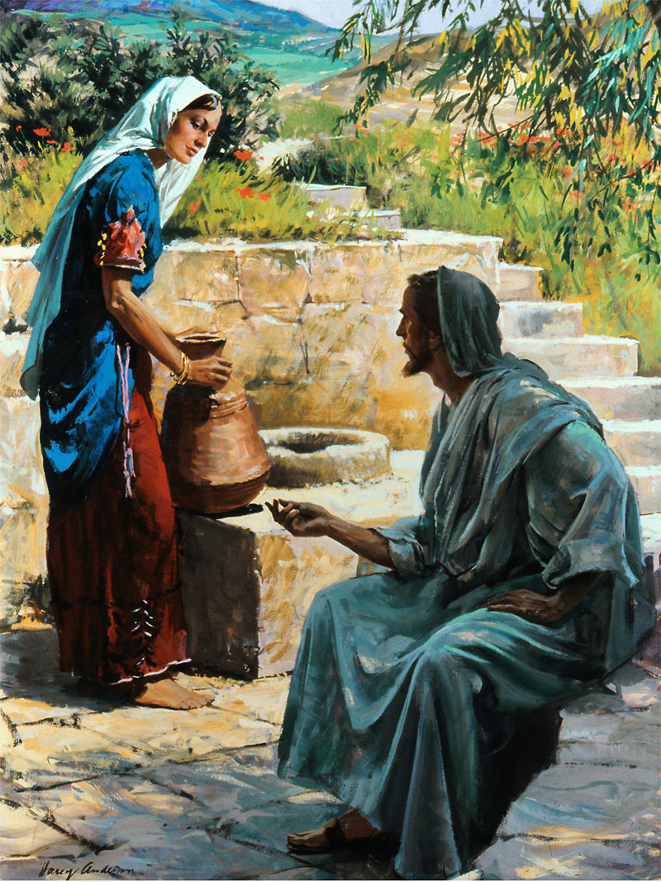
Who will the true worshippers worship?
John 4:23
But the hour cometh, and now is, when the true worshippers shall worship the Father in spirit and in truth: for the Father seeketh such to worship him.

Slide 13
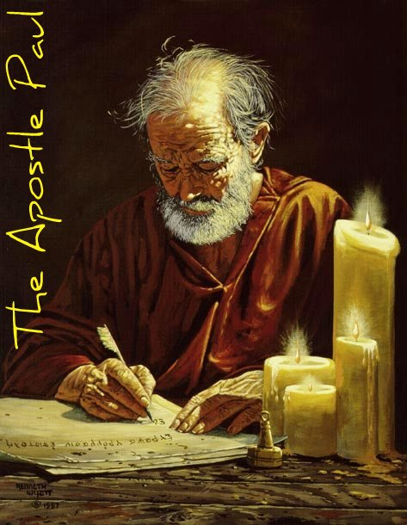
Who is the God of the Bible?
Who is God according to Paul?
1 Corinthians 8:4 – 6
There is no other God but One …
But to us there is but one God, the Father, of whom are all things, and we in him; and one Lord Jesus Christ, by whom are all things, and we by him.
Paul

Slide 14
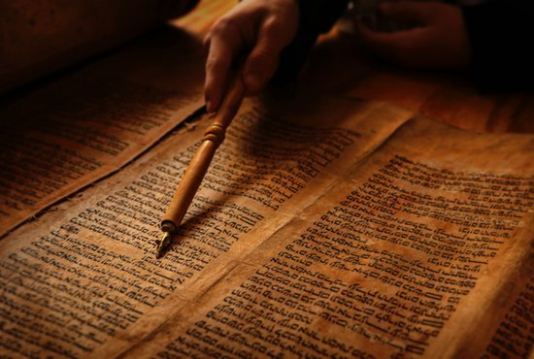
Who is the God of the Bible?
Who is God according to James?
James 3:9
Therewith bless we God, even the Father; and therewith curse we men, which are made after the similitude of God.”
James

Slide 15
Who is the God of the Bible?
Who is God according to Peter?
1 Peter 1:3
Blessed be the God and Father of our Lord Jesus Christ, which according to his abundant mercy hath begotten us again unto a lively hope by the resurrection of Jesus Christ from the dead,
Peter

Slide 16
Who is the God of the Bible?
Who is God according to John?
1 John 4:9, 10
In this was manifested the love of God toward us, because that God sent his only begotten Son into the world, that we might live through him. Herein is love, not that we loved God, but that he loved us, and sent his Son to be the propitiation for our sins.
John

Slide 17
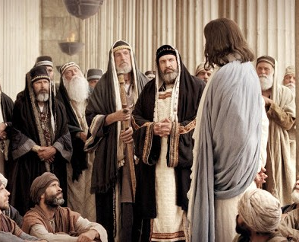
Who is the God of the Bible?
Who did Jesus claim to be?
John 10:36
Say ye of him, whom the Father hath sanctified, and sent into the world, Thou blasphemest; because I said, I am the Son of God?

Slide 18
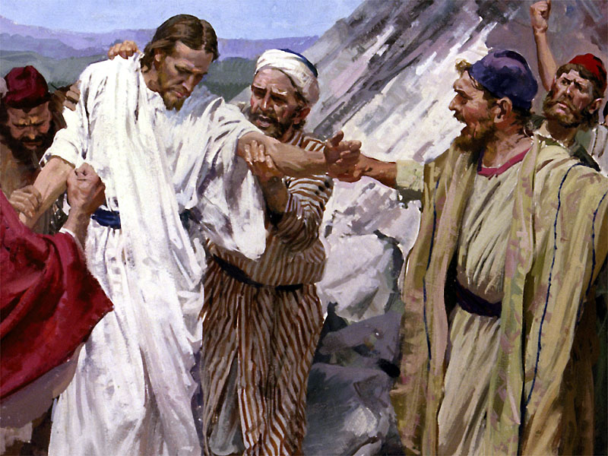
Who is the God of the Bible?
Who did Jesus claim to be?
John 5:18
Therefore the Jews sought the more to kill him, because he not only had broken the sabbath, but said also that God was his Father, making himself equal with God.

Slide 19
Who is the God of the Bible?
Who did Jesus claim to be?
John 19:7
The Jews answered him, We have a law, and by our law he ought to die, because he made himself the Son of God.

Slide 20
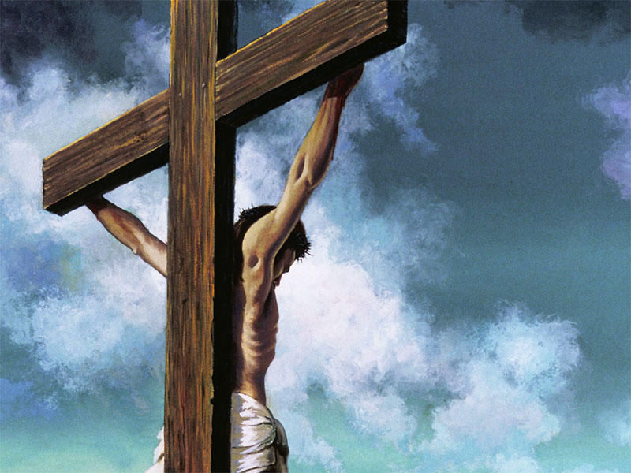
Who is the God of the Bible?
Who did Jesus claim to be?
Mat_27:43
He trusted in God; let him deliver him now, if he will have him: for he said, I am the Son of God.

Slide 21
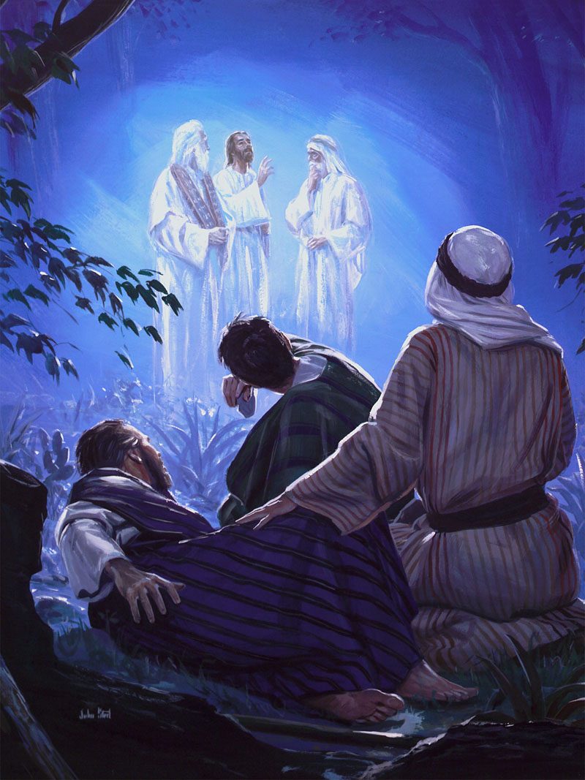
Who is Jesus according to God?
Matthew 17:5
While he yet spake, behold, a bright cloud overshadowed them: and behold a voice out of the cloud, which said, This is my beloved Son, in whom I am well pleased; hear ye him.

Slide 22
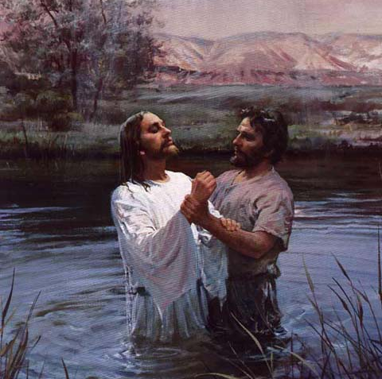
Who did the Disciples believe Jesus was?
John 1:34
And I saw, and bare record that this is the Son of God.
John the Baptist

Slide 23
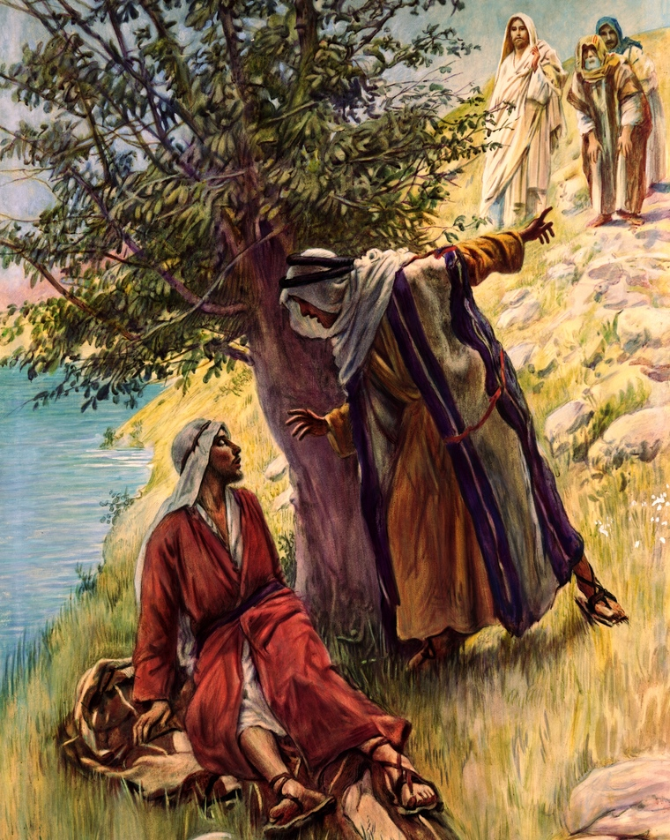
Who did the Disciples believe Jesus was?
John 1:49
Nathanael answered and saith unto him, Rabbi, thou art the Son of God; thou art the King of Israel.
Nathanael

Slide 24
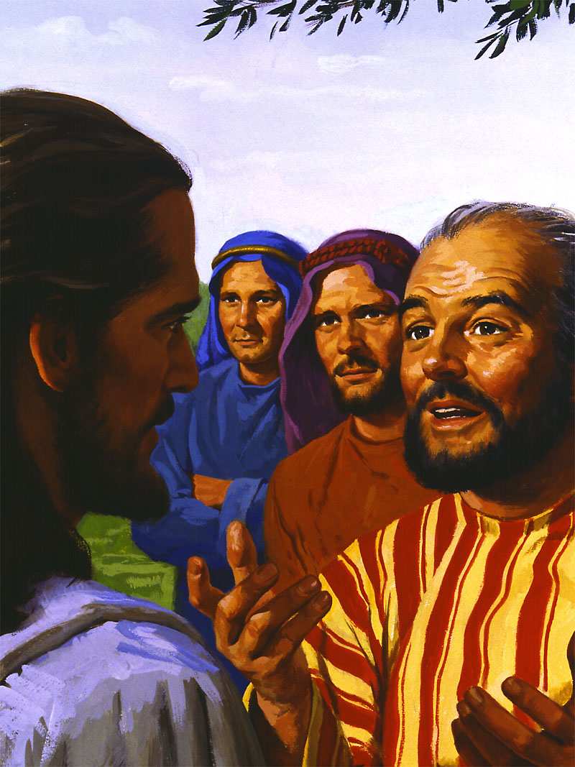
Who did the Disciples believe Jesus was?
Matthew 16:16
And Simon Peter answered and said, Thou art the Christ, the Son of the living God.
Peter

Slide 25
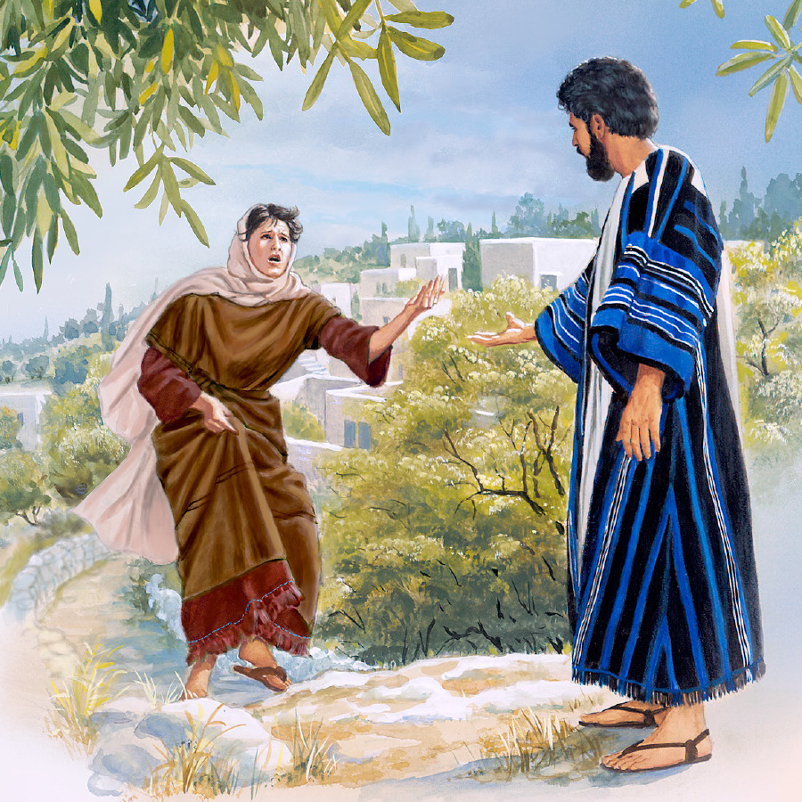
Who did the Disciples believe Jesus was?
John 11:27
She saith unto him, Yea, Lord: I believe that thou art the Christ, the Son of God, which should come into the world.
Martha

Slide 26
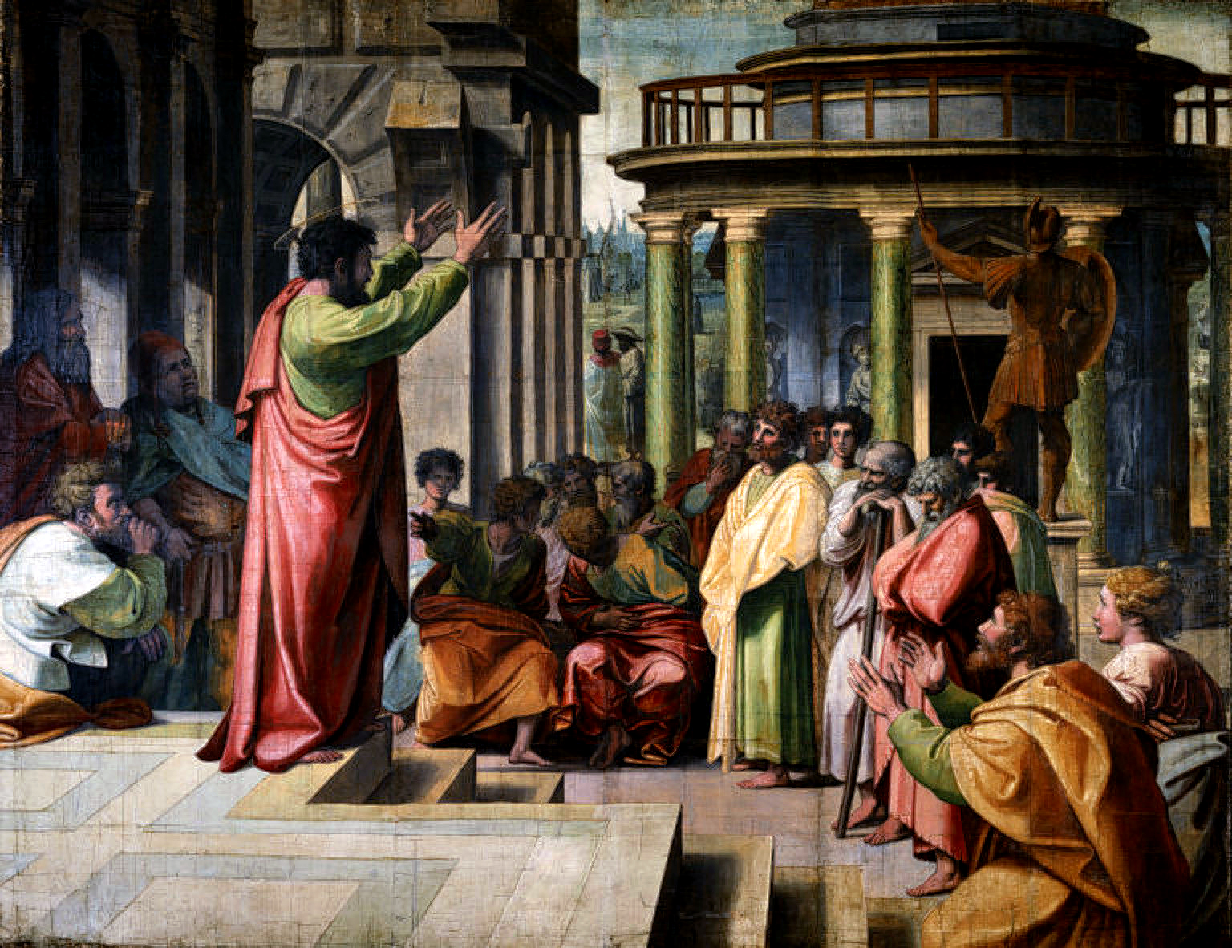
Who did the Disciples believe Jesus was?
Act 9:20
And straightway he preached Christ in the synagogues, that he is the Son of God.
Paul

Slide 27
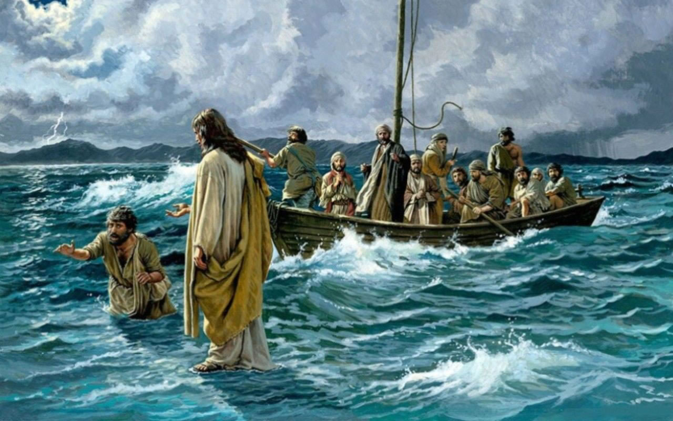
Who did the Disciples believe Jesus was?
Matthew 14:33
Then they that were in the ship came and worshipped him, saying, Of a truth thou art the Son of God.
The Apostles

Slide 28
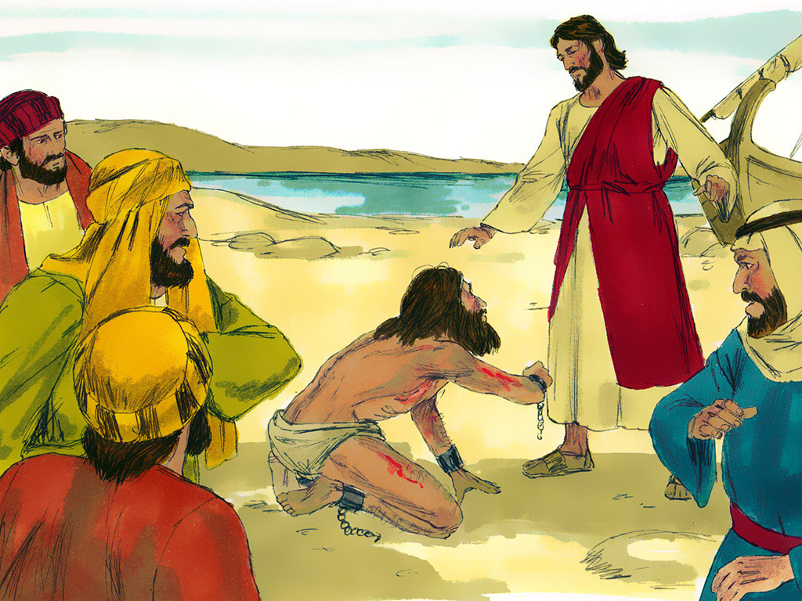
Who did the fallen angels believe Jesus was?
Luke 8:28
When he saw Jesus, he cried out, and fell down before him, and with a loud voice said, What have I to do with thee, Jesus, thou Son of God most high? I beseech thee, torment me not.
Fallen Angels

Slide 29
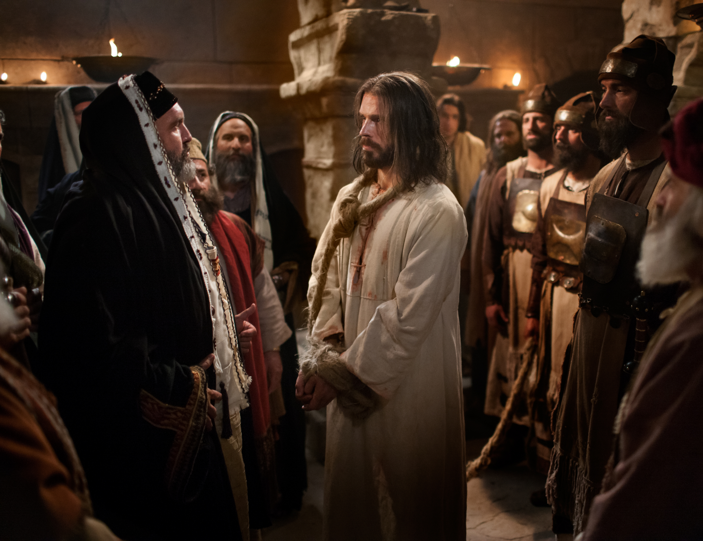
Jesus was crucified for confessing His Sonship!
Mar 14:61 But he held his peace, and answered nothing. Again the high priest asked him, and said unto him, Art thou the Christ, the Son of the Blessed?
Mar 14:62 And Jesus said, I am: and ye shall see the Son of man sitting on the right hand of power, and coming in the clouds of heaven.

Slide 30
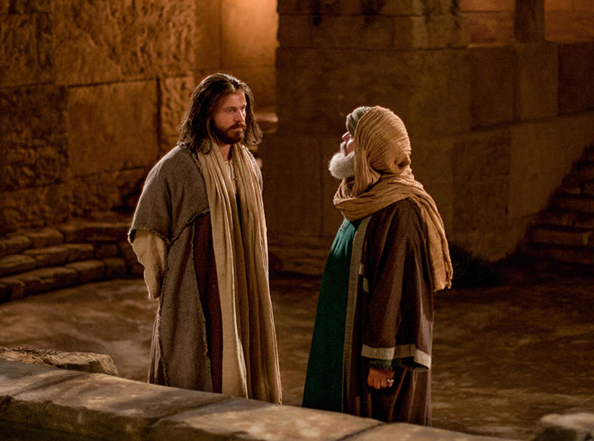
How is Jesus the Son?
John 3:16
For God so loved the world, that he gave his only begotten Son, that whosoever believeth in him should not perish, but have everlasting life.

Slide 31
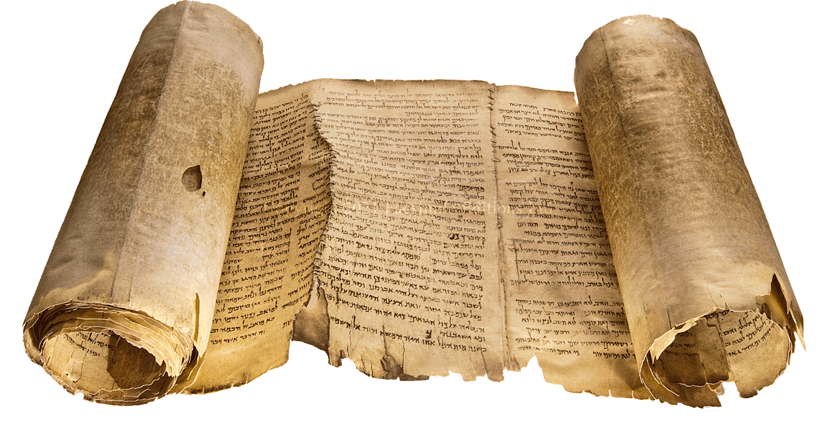
How is Jesus the Son?
Micah 5:2
But thou, Bethlehem Ephratah, though thou be little among the thousands of Judah, yet out of thee shall he come forth unto me that is to be ruler in Israel; whose goings forth have been from of old, from everlasting [days of eternity].

Slide 32
What happened in the days of eternity?
Pro 8:22 - 25
The LORD possessed me in the beginning of his way, before his works of old. I was set up from everlasting, from the beginning, or ever the earth was. When there were no depths, I was brought forth; when there were no fountains abounding with water. Before the mountains were settled, before the hills was I brought forth:

Slide 33
What happened in the days of eternity?
Joh 8:42
Jesus said unto them, If God were your Father, ye would love me: for I proceeded forth and came from God; neither came I of myself, but he sent me.

Slide 34
What happened in the days of eternity?
1Jn 4:9
In this was manifested the love of God toward us, because that God sent his only begotten Son into the world, that we might live through him.

Slide 35
Was Jesus referred to as the Son of God in the OT?
Proverbs 30:4
Who hath ascended up into heaven, or descended? who hath gathered the wind in his fists? who hath bound the waters in a garment? who hath established all the ends of the earth? what is his name, and what is his son's name, if thou canst tell?

Slide 36
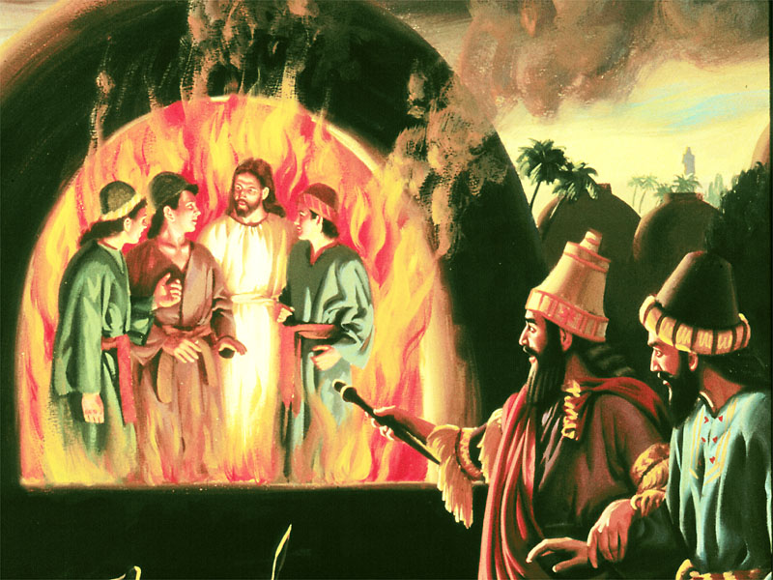
Was Jesus referred to as the Son of God in the OT?
Daniel 3:25
He answered and said, Lo, I see four men loose, walking in the midst of the fire, and they have no hurt; and the form of the fourth is like the Son of God.

Slide 37
What Did Christ inherit from the Father?
Hebrews 1:3, 4
Who being the brightness of his glory, and the express image of his person, and upholding all things by the word of his power, when he had by himself purged our sins, sat down on the right hand of the Majesty on high; Being made so much better than the angels, as he hath by inheritance obtained a more excellent name than they.

Slide 38
What Did Christ inherit from the Father?
Name in the bible means and signifies:
Nature (Genesis 5:2)
Character (Exodus 34:5-7)
Identity (Proverbs 30:4)
Reputation, fame, glory (Proverbs 22:1; Ecclesiastes 7:1)
Authority (John 5:43; John 10:25; Matthew 21:23;)
Power (Luke 9:1; 10:17; Acts 4:7)

Slide 39
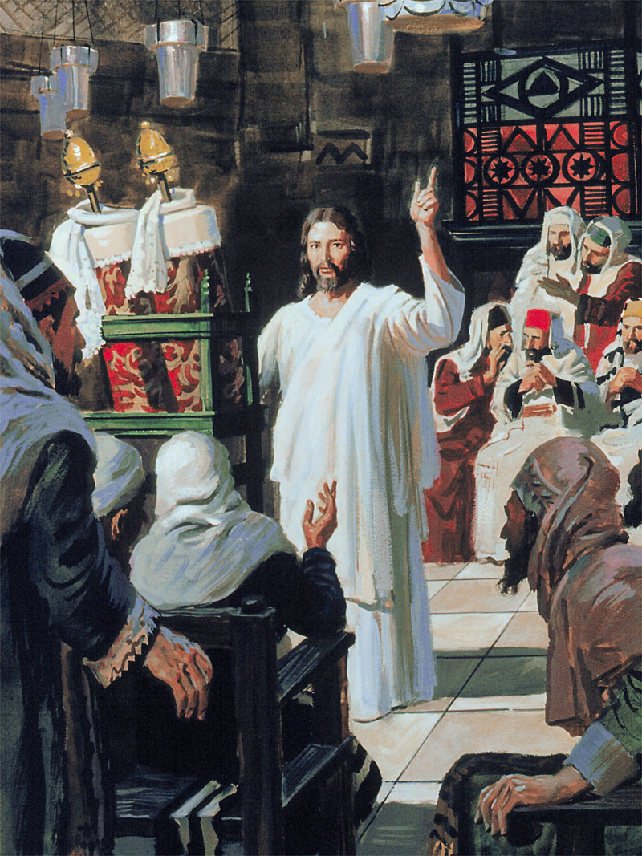
What Did Christ inherit from the Father?
John 5:26
For as the Father hath life in himself; so hath he given to the Son to have life in himself;

Slide 40
Equality of Christ
Was Christ equal with God in heaven?
Philippians 2:6
Who, being in the form of God, thought it not robbery to be equal with God

Slide 41
Jesus sonship makes Him divine?
Joh 5:18
Therefore the Jews sought the more to kill him, because he not only had broken the sabbath, but said also that God was his Father, making himself equal with God.

Slide 42
Is it important to believe that Jesus is the Son of God?
1 John 5:10
He that believeth on the Son of God hath the witness in himself: he that believeth not God hath made him a liar; because he believeth not the record that God gave of his Son.

Slide 43
Is it important to believe that Jesus is the Son of God?
1 John 5:5
Who is he that overcometh the world, but he that believeth that Jesus is the Son of God?

Slide 44
Why did John write the Gospel?
John 20:31
But these are written, that ye might believe that Jesus is the Christ, the Son of God; and that believing ye might have life through his name.

Slide 45

Gen 1:27
So God created man in his own image, in the image of God created he him; male and female created he them.

Slide 46
God has a Shape
John 5:37
And the Father himself, which hath sent me, hath borne witness of me. Ye have neither heard his voice at any time, nor seen his shape.

Slide 47
God has a Face
Matthew 18:10
Take heed that ye despise not one of these little ones; for I say unto you, That in heaven their angels do always behold the face of my Father which is in heaven.

Slide 48
Will we See God?
Matthew 5:8
Blessed are the pure in heart: for they shall see God.

Slide 49
Is God only ‘physical’?
John 4:24
God is a Spirit: and they that worship him must worship him in spirit and in truth.

Slide 50
What is relationship between Man & His Spirit?
1 Corinthians 2:11
For what man knoweth the things of a man, save the spirit of man which is in him? even so the things of God knoweth no man, but the Spirit of God.

Slide 51
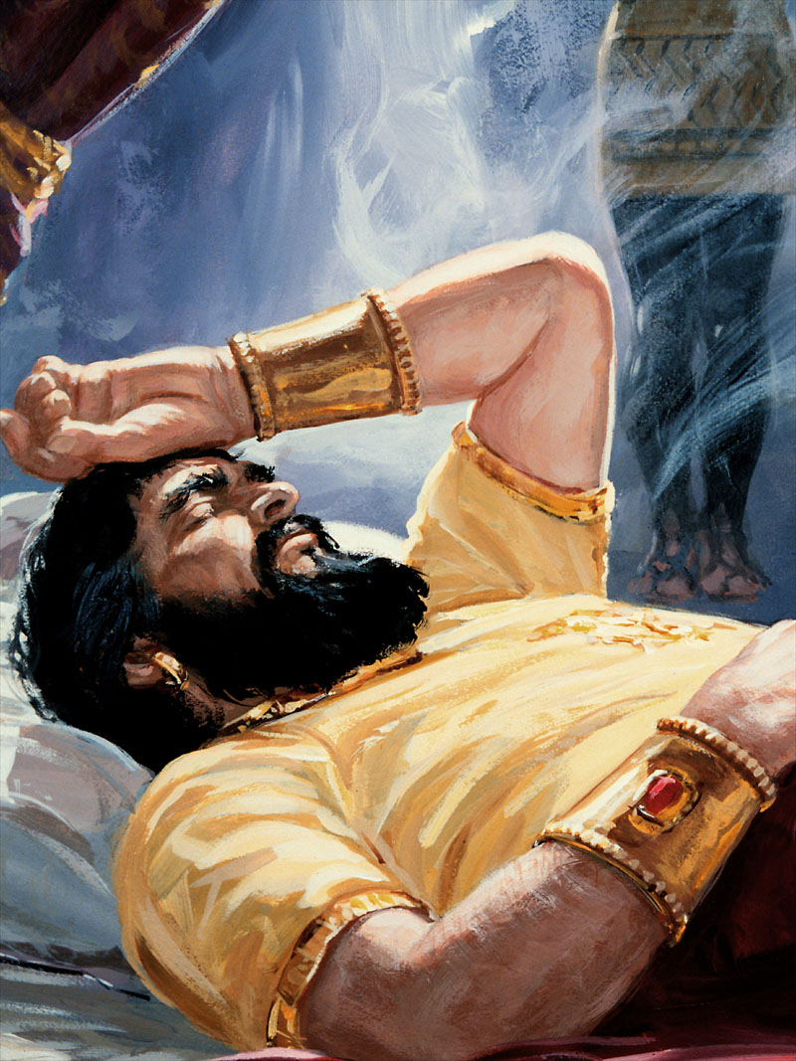
What is relationship between Man & His Spirit?
Daniel 2:1
And in the second year of the reign of Nebuchadnezzar Nebuchadnezzar dreamed dreams, wherewith his spirit was troubled, and his sleep brake from him.

Slide 52
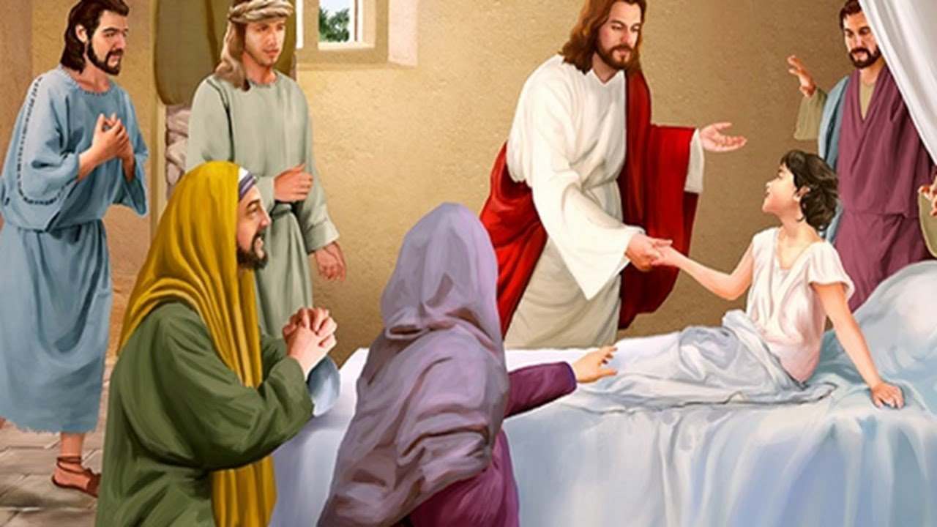
Spirit = Life
Luke 8:55
And her spirit came again, and she arose straightway: and he commanded to give her meat.

Slide 53
God’s Spirit is His Presence
Psalm 51:11
Cast me not away from thy presence; and take not thy holy spirit from me.
See also Ps 139:7

Slide 54
How many spirits are there?
Ephesians 4:4
There is one body, and one Spirit, even as ye are called in one hope of your calling;

Slide 55
What Spirit do we receive?
1 Co 3:16
Know ye not that ye are the temple of God, and that the Spirit of God dwelleth in you?

Slide 56
Where does the Spirit come from?
John 15:26
But when the Comforter is come, whom I will send unto you from the Father, even the Spirit of truth, which proceedeth from the Father, he shall testify of me:

Slide 57
Why from the Father?
1 Corinthians 8:6
But to us there is but one God, the Father, of whom are all things, and we in him; and one Lord Jesus Christ, by whom are all things, and we by him.

Slide 58
Through Whom does the spirit Come?
Eph 2:18
For through him [Jesus] we both have access by one Spirit unto the Father.

Slide 59
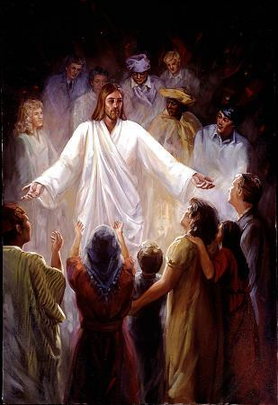
Through Whom does the spirit Come?
John 20:22
And when he had said this, he breathed on them, and saith unto them, Receive ye the Holy Ghost:

Slide 60
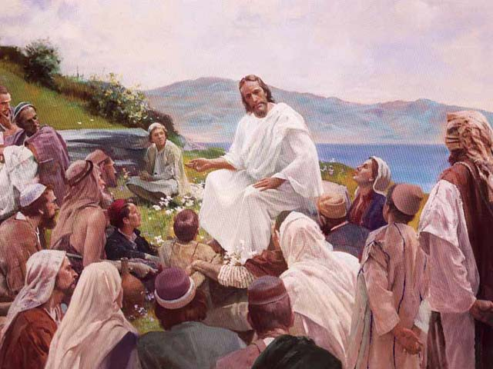
When we receive the spirit, Who do we receive?
John 14:23
Jesus answered and said unto him, If a man love me, he will keep my words: and my Father will love him, and we will come unto him, and make our abode with him.

Slide 61
God was In Christ
2 Corinthians 5:19
To wit, that God was in Christ, reconciling the world unto himself, not imputing their trespasses unto them; and hath committed unto us the word of reconciliation.

Slide 62
Who is the Comforter? Who will the Father Send?
Galatians 4:6
And because ye are sons, God hath sent forth the Spirit of his Son into your hearts, crying, Abba, Father.

Slide 63
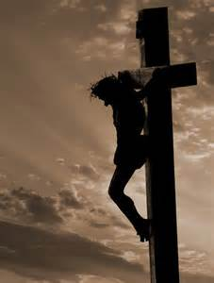
Is the Spirit of Jesus, Jesus Himself?
Luke 23:46
And when Jesus had cried with a loud voice, he said, Father, into thy hands I commend my spirit: and having said thus, he gave up the ghost.

Slide 64
Is Jesus the Spirit we Receive?
2 Co 3:17
Now the Lord is that Spirit: and where the Spirit of the Lord is, there is liberty.
1Co 8:6 …. and one Lord Jesus Christ, by whom are all things, and we by him.

Slide 65
Is Jesus the Spirit we Receive?
1 Co 15:45
And so it is written, The first man Adam was made a living soul; the last Adam was made a quickening spirit.

Slide 66
Christ in you
Colossians 1:26, 27
Christ in you, the hope of glory”
2Co 13:5
Examine yourselves, whether ye be in the faith; prove your own selves. Know ye not your own selves, how that Jesus Christ is in you, except ye be reprobates?

Slide 67
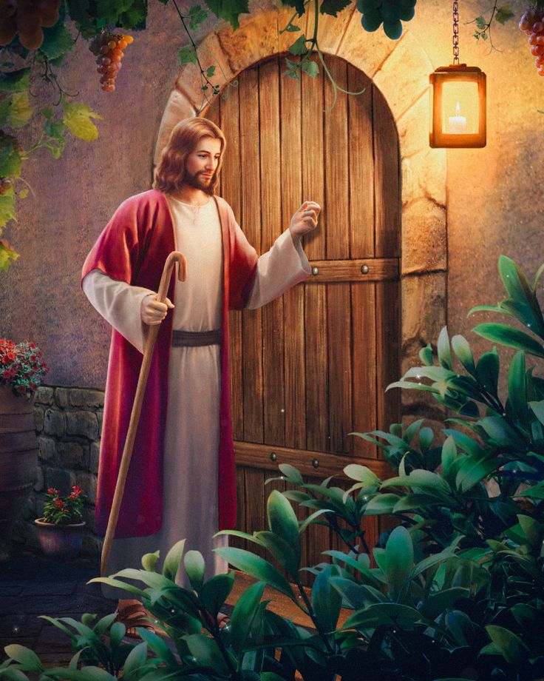
Jesus knocking on your heart
Rev 3:20
Behold, I stand at the door, and knock: if any man hear my voice, and open the door, I will come in to him, and will sup with him, and he with me.

Slide 68
1 Jn 5:11 - 13
And this is the record, that God hath given to us eternal life, and this life is in his Son. He that hath the Son hath life; and he that hath not the Son of God hath not life. These things have I written unto you that believe on the name of the Son of God; that ye may know that ye have eternal life, and that ye may believe on the name of the Son of God.

Slide 69
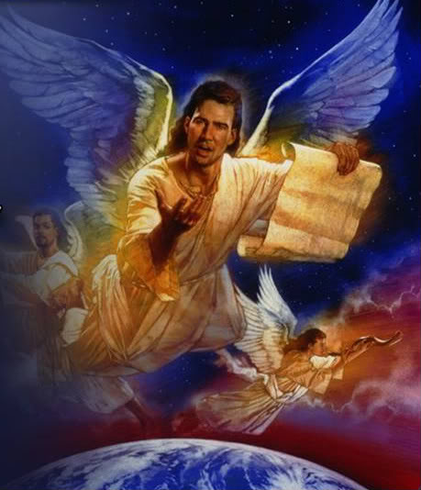
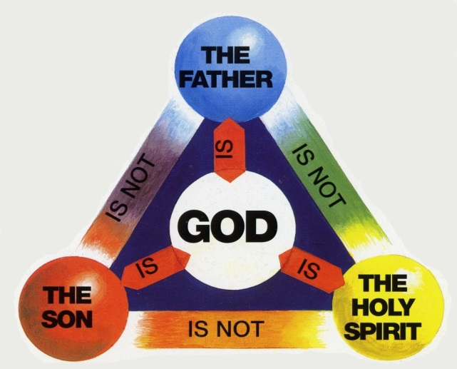
1 Kings 18:21
How long halt ye between two opinions? if the LORD be God, follow him: but if Baal, then follow him
OR

